Slide 1



HR_absenteeism_analysis
View in Power BI
Last data refresh:
9/2/2023 4:00:54 PM UTC
Downloaded at:
9/5/2023 4:42:16 PM UTC

Slide 2
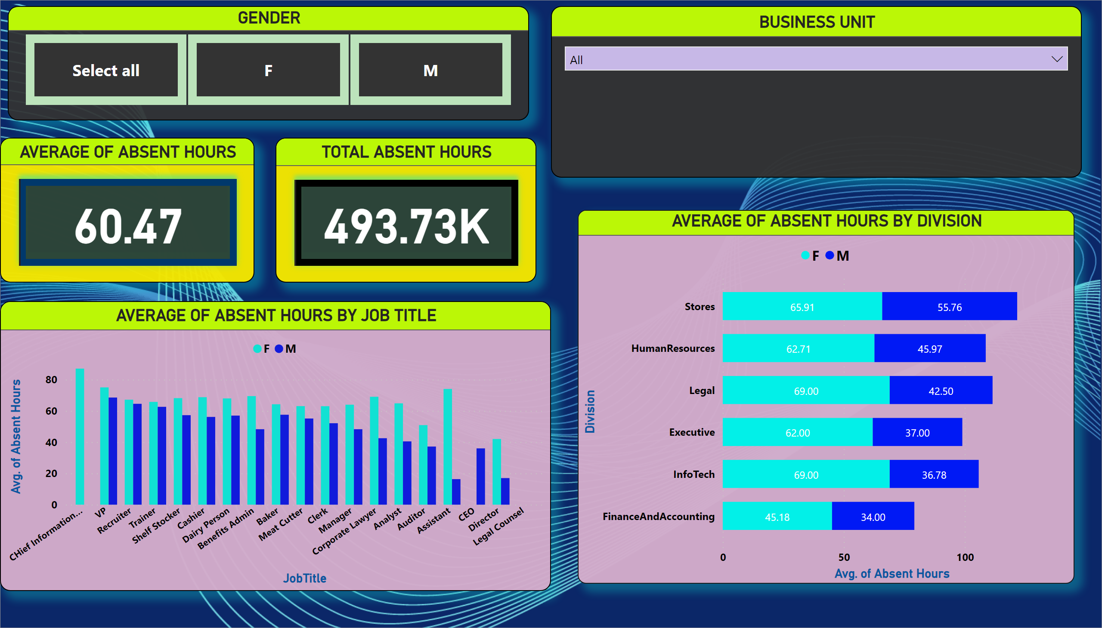
Page 1
Notes:
GENDER
No alt text provided
BUSINESS UNIT
No alt text provided
AVERAGE OF ABSENT HOURS
No alt text provided
TOTAL ABSENT HOURS
No alt text provided
AVERAGE OF ABSENT HOURS BY JOB TITLE
No alt text provided
AVERAGE OF ABSENT HOURS BY DIVISION
No alt text provided

Slide 3
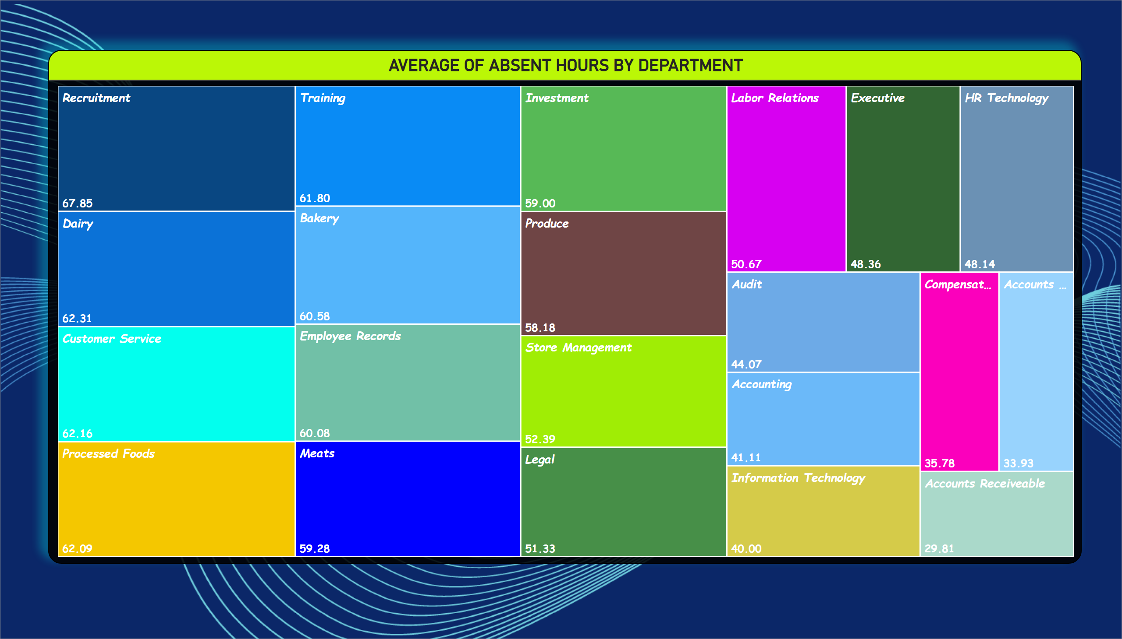
Page 2
Notes:
AVERAGE OF ABSENT HOURS BY DEPARTMENT
No alt text provided

Slide 4
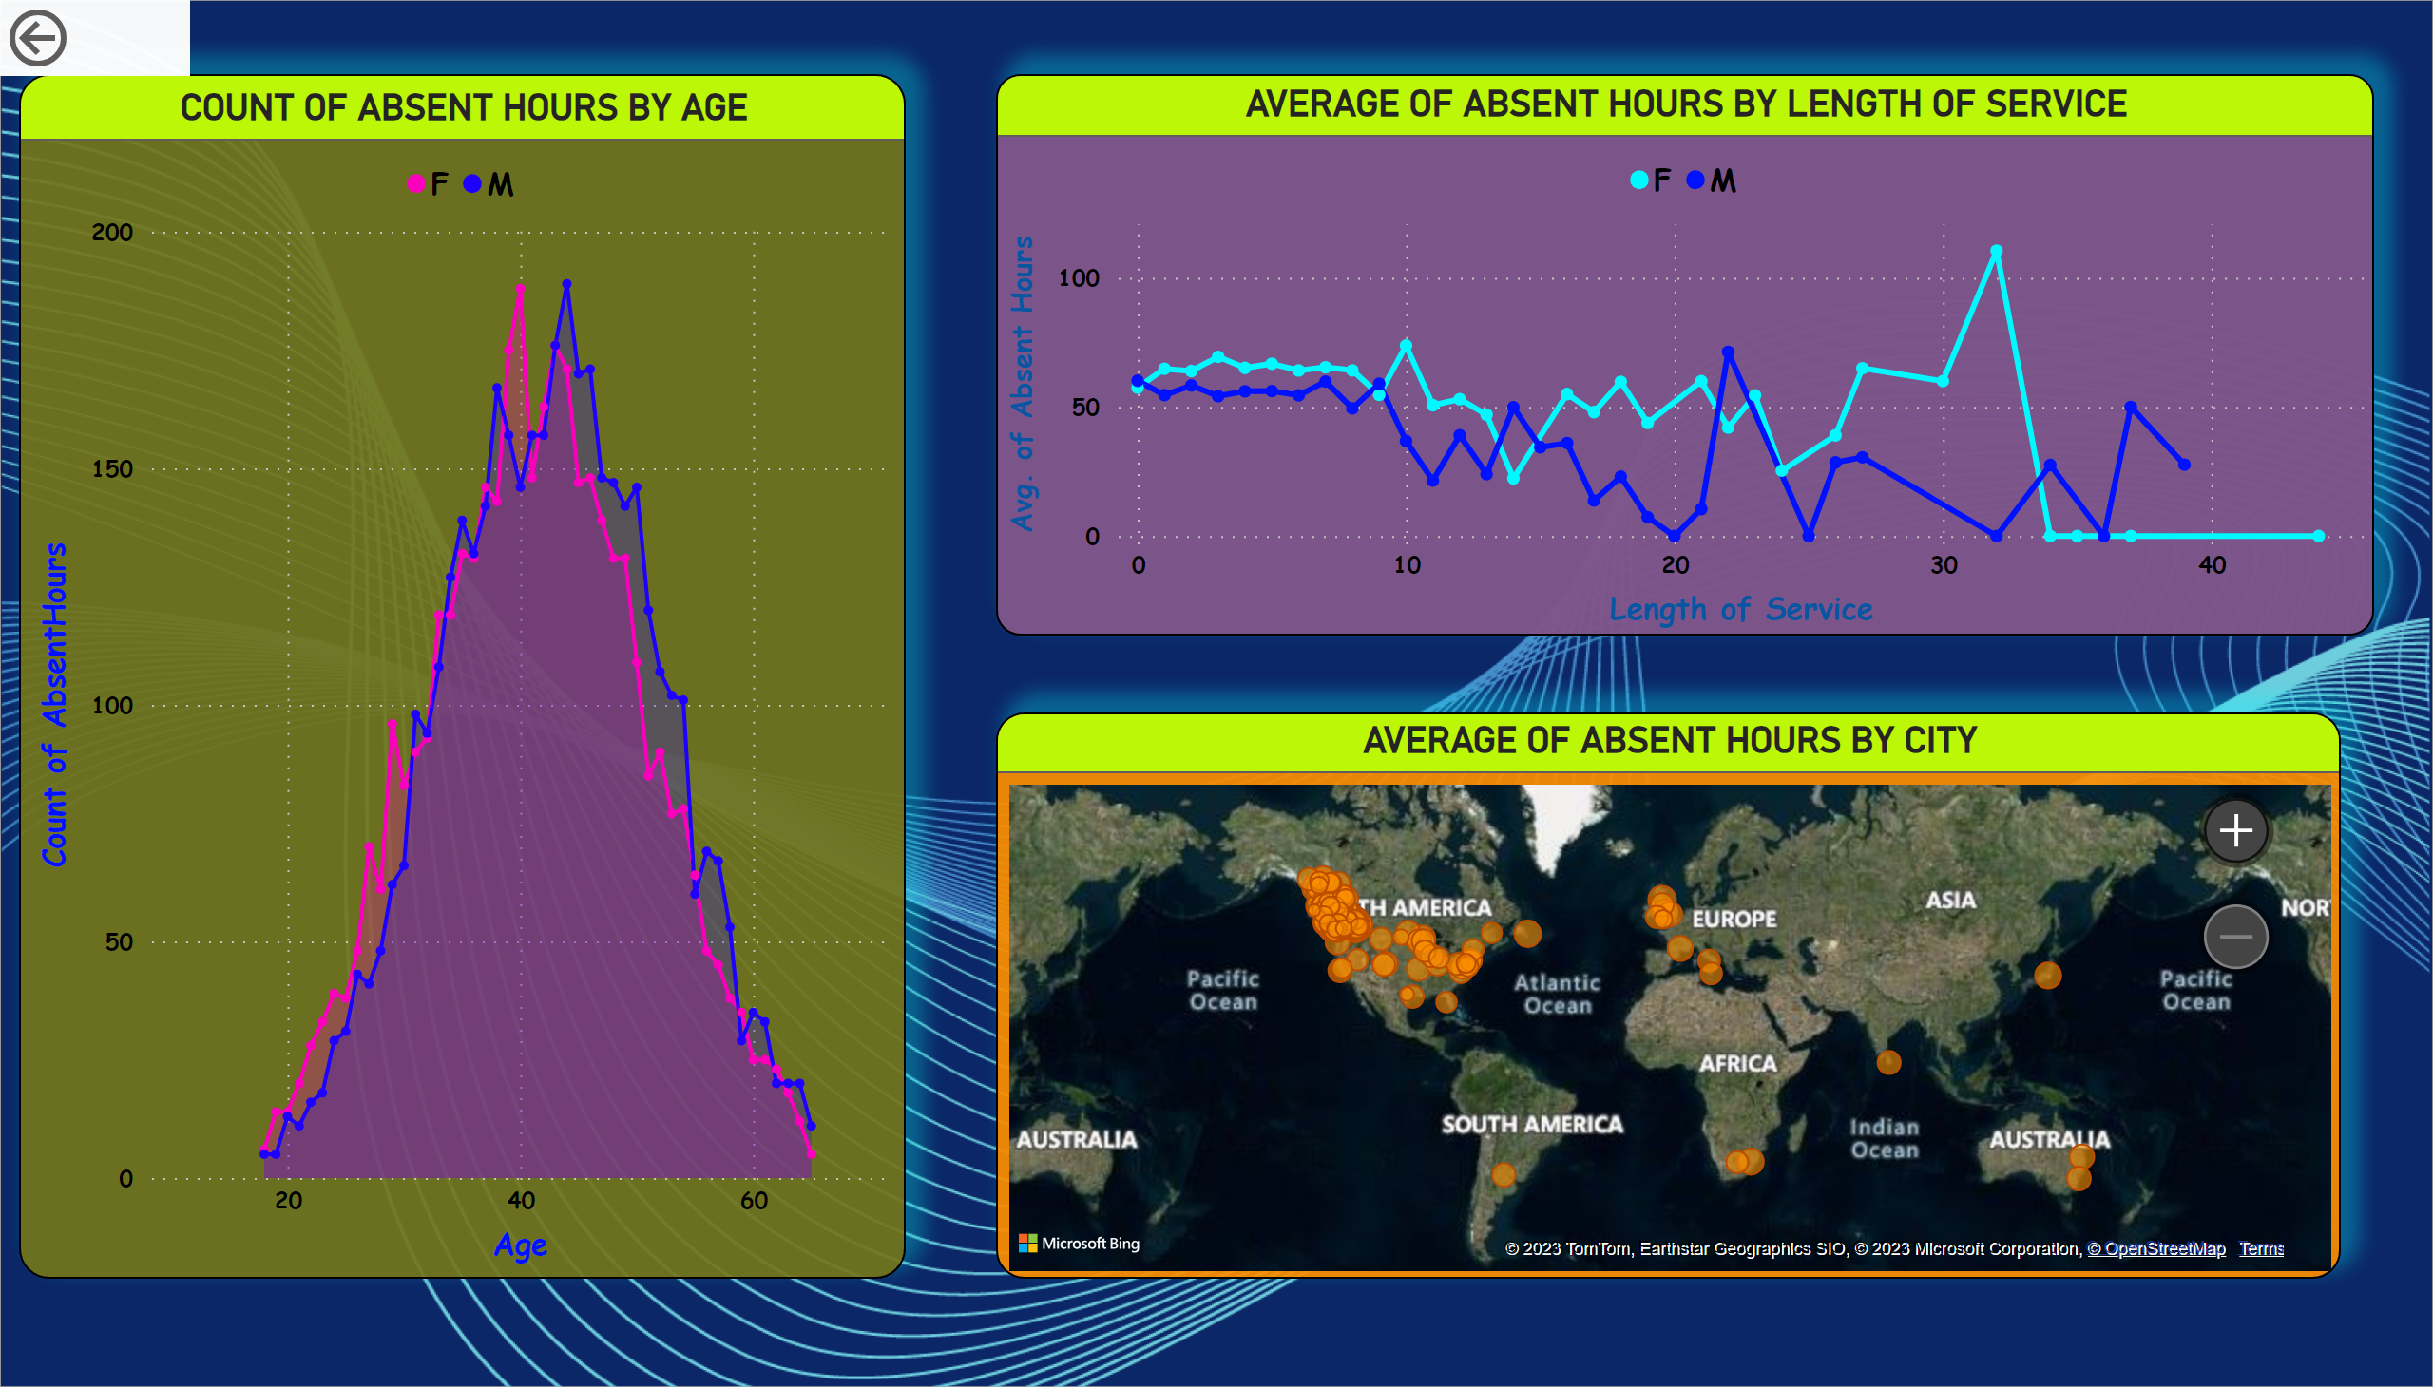
Page 3
Notes:
COUNT OF ABSENT HOURS BY AGE
No alt text provided
AVERAGE OF ABSENT HOURS BY LENGTH OF SERVICE
No alt text provided
AVERAGE OF ABSENT HOURS BY CITY
No alt text provided
actionButton
No alt text provided

Slide 5
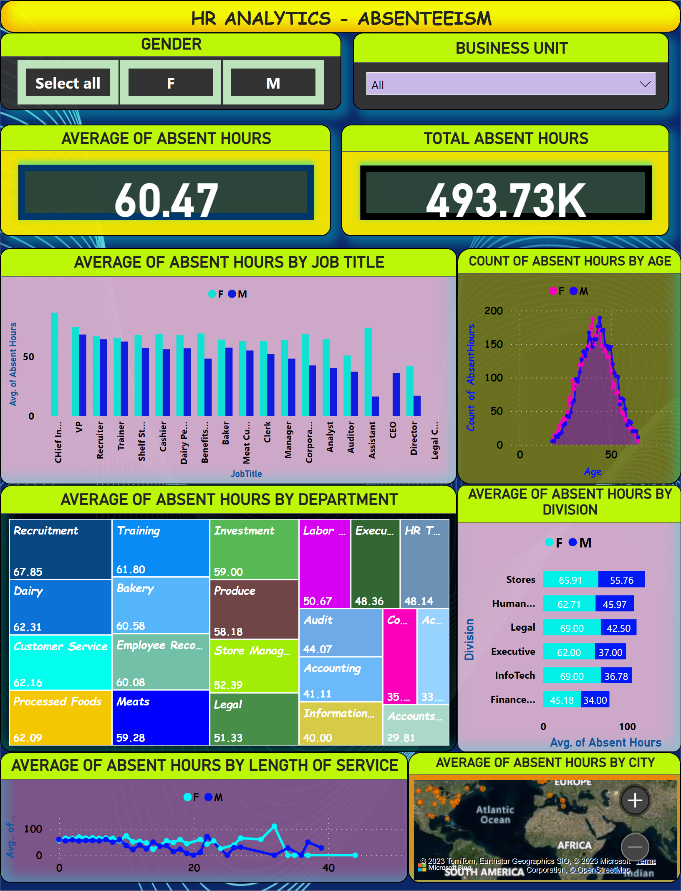
DASHBOARD
Notes:
HR ANALYTICS - ABSENTEEISM
No alt text provided
GENDER
No alt text provided
BUSINESS UNIT
No alt text provided
AVERAGE OF ABSENT HOURS
No alt text provided
TOTAL ABSENT HOURS
No alt text provided
AVERAGE OF ABSENT HOURS BY JOB TITLE
No alt text provided
COUNT OF ABSENT HOURS BY AGE
No alt text provided
AVERAGE OF ABSENT HOURS BY DEPARTMENT
No alt text provided
AVERAGE OF ABSENT HOURS BY DIVISION
No alt text provided
AVERAGE OF ABSENT HOURS BY LENGTH OF SERVICE
No alt text provided
AVERAGE OF ABSENT HOURS BY CITY
No alt text provided

Slide 6
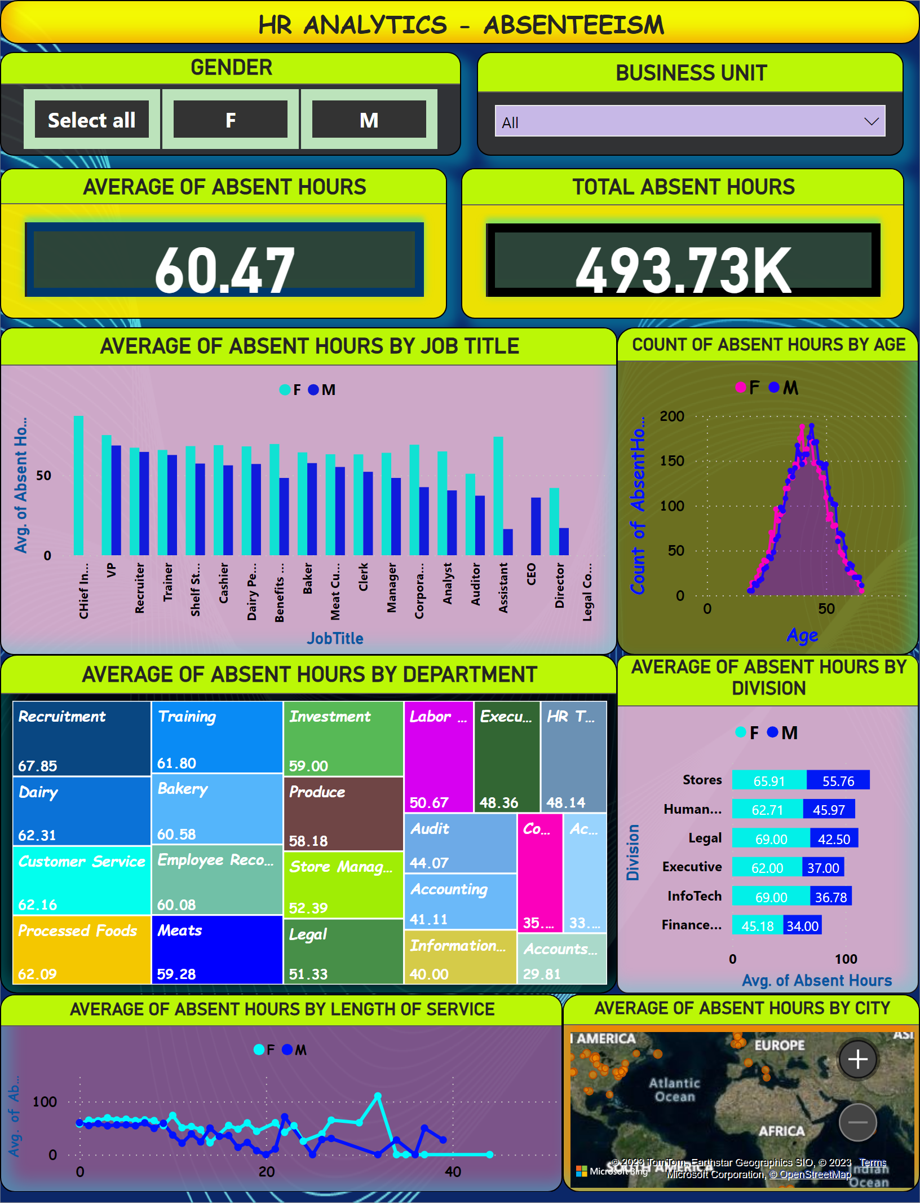
Duplicate of DASHBOARD
Notes:
HR ANALYTICS - ABSENTEEISM
No alt text provided
GENDER
No alt text provided
BUSINESS UNIT
No alt text provided
AVERAGE OF ABSENT HOURS
No alt text provided
TOTAL ABSENT HOURS
No alt text provided
AVERAGE OF ABSENT HOURS BY JOB TITLE
No alt text provided
COUNT OF ABSENT HOURS BY AGE
No alt text provided
AVERAGE OF ABSENT HOURS BY DEPARTMENT
No alt text provided
AVERAGE OF ABSENT HOURS BY DIVISION
No alt text provided
AVERAGE OF ABSENT HOURS BY LENGTH OF SERVICE
No alt text provided
AVERAGE OF ABSENT HOURS BY CITY
No alt text provided

Slide 7
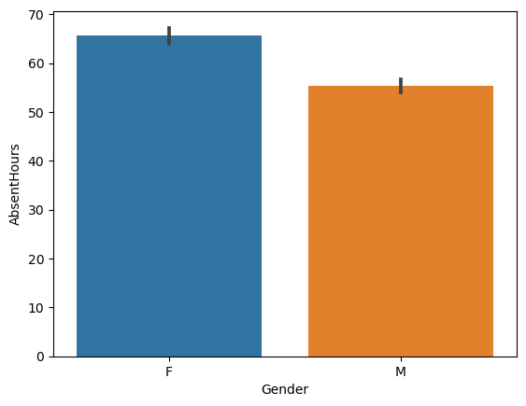
BAR PLOT
Females have more absent hours than males

Slide 8
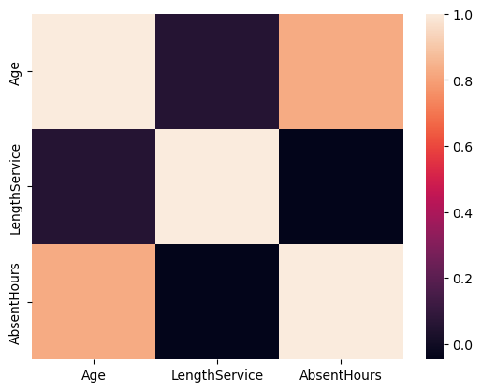
HEAT MAP
As employees age, they are more absent than when they first joined.

Slide 9
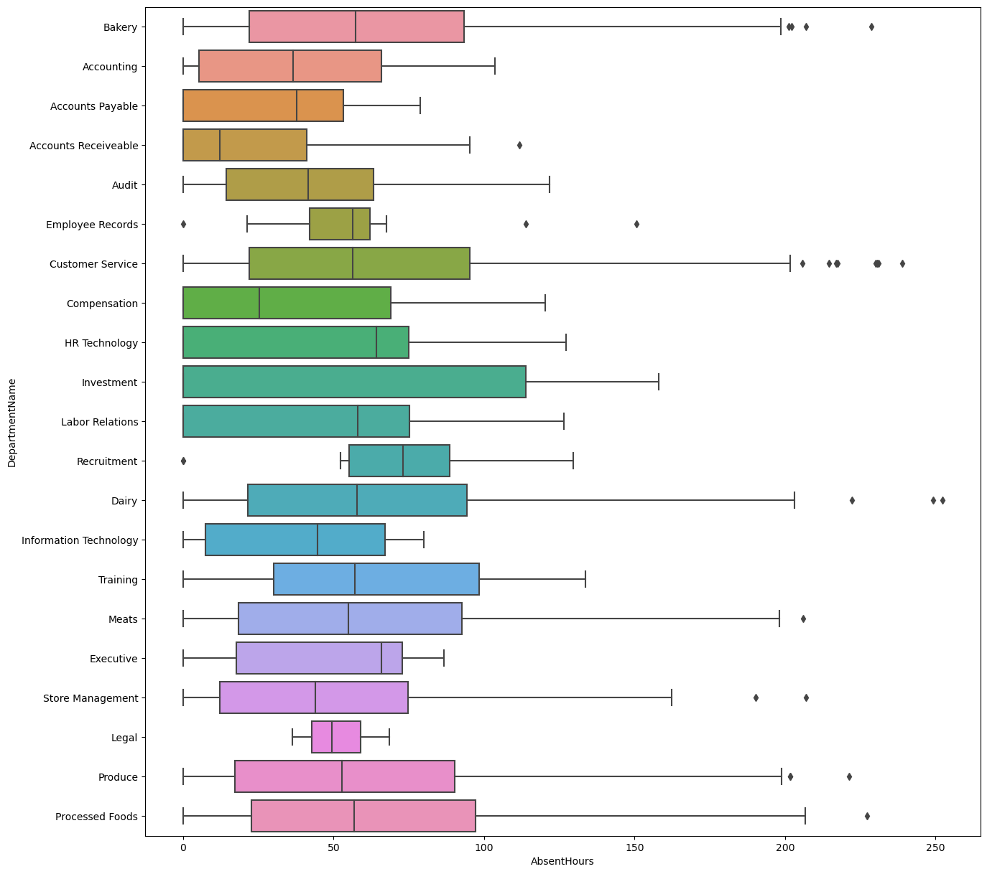
BOX PLOT
There are relatively many outliers in Bakery and Customer service department

Slide 10
Final Insights:-
The ratio of men and women working are almost equal.
The employees working in Stores are more as compared to Head office.
Most of the stores are present in Vancouver,Victoria,Nanaoimo, New Westminster in the following order.
Most of the people are working as Cashier then as Dairy Persons
Age and Absent Hours are highly correlated. we can say higher the age higher will be the absent hours.
Scatterplot shows the relations between Age and Absent Hours as age increases, Absent Hours also increases.
From the Bar plot between Gender and Absent Hours we can say that female ought to have more absent hours.
And from Boxplot we can say that females have more outliers.
As we can see from the boxplot between Absent Hours and Store Location Vancouver has the most outliers than any store location which means, many employees with high number of absent hours are from Vancouver.
We can see employees who were working as Cashiers were comparatively Absent more.
Customer Service' and 'Bakery' have the most outliers i.e. Employee from these department have the Most Absent Hours

